Slide 1
Victorian Architecture
By Stephen Weiland

Slide 2
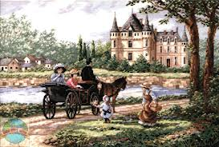
Background information
originating in Great Britain it spread to its colonies as time pasted
  America 1860’s-1900’s(los Angeles)
With the industrial revolution in full swing, the population boomed and the need for large housing came to light.
Resources like precut lumber and stone were made available, thus the house were mainly build out it.

Slide 3
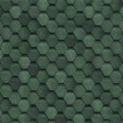
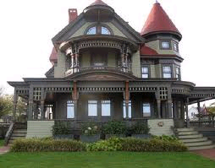
Textured shingles
Steeply pitched roofs
2-3 floors
A high partial or full width porch
Asymmetrically balanced
Notes:
Color is the most notable with this style of house, the era was a new age of bright colors that didn’t exist before.
The textured wooden shingles along the sides and the roof were to move away from the smooth sides of the past.
Asymmetrically balanced with steeped roofs and tall porches.
Most often they were very unified in both sides and the color of the interior and out side.

Slide 4
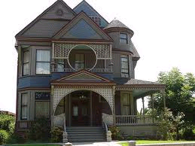
Works cited
http://www.houzz.com/ideabooks/1934137/list/Global-Architecture-Style--Victorian
http://heritage.vic.gov.au/Heritage-places-objects/What-house-is-that/index_over.html

